Slide 1
Syntax-Directed Translation

Slide 2
Syntax-Directed Translation
Attributes associate information with the programming language constructs that they represent.
Values of these attributes are evaluated by the semantic rules associated with the production rules.
Evaluation of these semantic rules:
  may generate intermediate codes
  may put information into the symbol table
  may perform type checking
  may issue error message
An attribute may hold almost any thing.
  a string, a number, a memory location, a complex record.

Slide 3
Syntax-Directed Definitions and Translation Schemes
When we associate semantic rules with productions, we use two notations:
  Syntax-Directed Definitions
  Translation Schemes
Syntax-Directed Definitions:
  give high-level specifications for translations
  hide many implementation details such as order of evaluation of semantic actions.
  We associate a production rule with a set of semantic actions, and we do not say when they will be evaluated.
Translation Schemes:
  indicate the order of evaluation of semantic actions associated with a production rule.
  In other words, translation schemes give a little bit information about implementation details.

Slide 4
Syntax-Directed Definitions
A syntax directed definition specifies the values of attributes by associating semantic rules with the grammar productions.
A syntax-directed definition is a generalization of a context-free grammar in which:
  Each grammar symbol is associated with a set of attributes.
  This set of attributes for a grammar symbol is partitioned into two subsets called
    A synthesized attribute at node N is defined only in terms of attribute values of children of N and at N it
    inherited attribute at node N is defined only in terms of attribute values at N’s parent, N itself and N’s siblings
  Each production rule is associated with a set of semantic rules.
Evaluation of a semantic rule defines the value of an attribute. But a semantic rule may also have some side effects such as printing a value.

Slide 5
Syntax-Directed Definition
In a syntax-directed definition, each production A→α is associated with a set of semantic rules of the form:
b=f(c₁,c₂,…,c_{n})
where f is a function and b can be one of the followings:
➔ b is a synthesized attribute of A and c₁,c₂,…,c_{n} are attributes of the grammar symbols in the production ( A→α ).
OR
➔ b is an inherited attribute one of the grammar symbols in α (on the right side of the production), and c₁,c₂,…,c_{n} are attributes of the grammar symbols in the production ( A→α ).

Slide 6
Annotated Parse Tree
A parse tree showing the values of attributes at each node is called an annotated parse tree.
The process of computing the attributes values at the nodes is called annotating (or decorating) of the parse tree.
Of course, the order of these computations depends on the dependency graph induced by the semantic rules.

Slide 7
Syntax-Directed Definition – Synthesized Atttibutes
Production Semantic Rules
L → E return print(E.val)
E → E₁ + T E.val = E₁.val + T.val
E → T E.val = T.val
T → T₁ * F T.val = T₁.val * F.val
T → F T.val = F.val
F → ( E ) F.val = E.val
F → digit F.val = digit.lexval (from symbol table)
Symbols E, T, and F are associated with a synthesized attribute val.
The token digit has a synthesized attribute lexval (it is assumed that it is evaluated by the lexical analyzer).

Slide 8
Annotated Parse Tree -- Example
Input: 5+3*4
L
E.val=17 return print(E.val)
E.val=5 + T.val=12
T.val=5 T.val=3 * F.val=4
F.val=5 F.val=3 digit.lexval=4
digit.lexval=5 digit.lexval=3

Slide 9
Dependency Graph
Dependency graph shows the flow of information among the attribute instances in parse tree. It is used to determine the order of computation of attributes
Semantic rules set up dependencies between attributes which can be represented by a dependency graph.
This dependency graph determines the evaluation order of these semantic rules.

Slide 10
Dependency Graph
Input: 5+3*4
L
E.val=17
E.val=5 T.val=12
T.val=5 T.val=3 F.val=4
F.val=5 F.val=3 digit.lexval=4
digit.lexval=5 digit.lexval=3

Slide 11
Syntax-Directed Definition – Inherited Attributes
Production Semantic Rules
D → T L; L.in = T.type
T → int T.type = integer
T → real T.type = real
L → L₁ ,id L₁.in = L.in, addtype(id.entry,L.in)
L → id addtype(id.entry,L.in)
Symbol T is associated with a synthesized attribute type.
Symbol L is associated with an inherited attribute in.

Slide 12
Annotated Parse Tree for real, id1, id2, id3
Annotated Parse Tree for real id1, id2, id3
D
T.Type = real
L.in = real
L.in = real
,
id3
real
L.In = real
,
id2
id1

Slide 13
A Dependency Graph – Inherited Attributes
Input: real p q
D L.in=real
T L T.type=real L₁.in=real addtype(q,real)
real L id addtype(p,real) id.entry=q
id id.entry=p
parse tree dependency graph

Slide 14
Example of mixed attributes
Production
Semantic Rules
T → FT’
T’ → *FT₁’
T’ → ε
F → digit
T’.inh = F.val
T.val = T’.syn
T₁’.inh = T’.inh * F.val
T’.syn = T’1.syn
T’.syn = T’.inh
F.val = digit.lexval

Slide 15
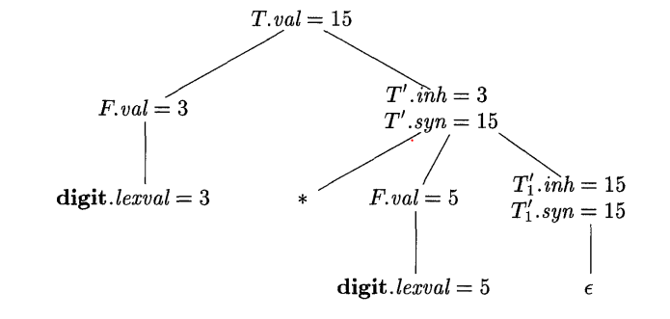

Slide 16
S-Attributed definitions
An SDD is S-attributed if every attribute is synthesized
We can have a post-order traversal of parse-tree to evaluate attributes in S-attributed definitions
postorder(N) {
for (each child C of N, from the left) postorder(C);
evaluate the attributes associated with node N;
}
S-Attributed definitions can be implemented during bottom-up parsing without the need to explicitly create parse trees

Slide 17
L-Attributed definitions
A SDD is L-Attributed if the edges in dependency graph goes from Left to Right but not from Right to Left.
More precisely, each attribute must be either
  Synthesized
  OR
  Inherited, but if there us a production A->X1X2…Xn and there is an inherited attribute Xi.a computed by a rule associated with this production, then the rule may only use:
    Inherited attributes associated with the head A
    Either inherited or synthesized attributes associated with the occurrences of symbols X1,X2,…,Xi-1 located to the left of Xi
    Inherited or synthesized attributes associated with this occurrence of Xi itself, but in such a way that there is no cycle in the graph

Slide 18
Syntax Trees
Decoupling Translation from Parsing-Trees.
Syntax-Tree: an intermediate representation of the compiler’s input.
Example Procedures:
new node, new leaf
Employment of the synthesized attribute node (pointer)
PRODUCTION SEMANTIC RULE
E → E₁ + T E.node = new node(‘+’,E₁.node ,T.node)
E → E₁ - T E.node = new node(‘-’,E₁.node ,T.node)
E → T E.node = T.node
T → (E) T.node = E.node
T → id T.node = new leaf(id, id.lexval)
T → num T.node = new leaf(num, num.val)

Slide 19
Draw the Syntax Tree
a-4+c
id
to entry for c
id
num 4
to entry for a

